Slide 1
3D Printing

Slide 2
The Process
Create 3D model
Convert model to generic 3D file (STL)
Load generic file into printer software
“Slice” the 3D file into layer
Determine support structures
Print model one layer at a time

Slide 3
The Materials
Powders
Plastics
Resins
Metals
Anything that can be extruded
Anything that can be selectively cured

Slide 4
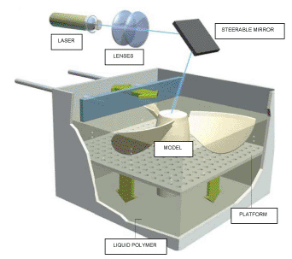
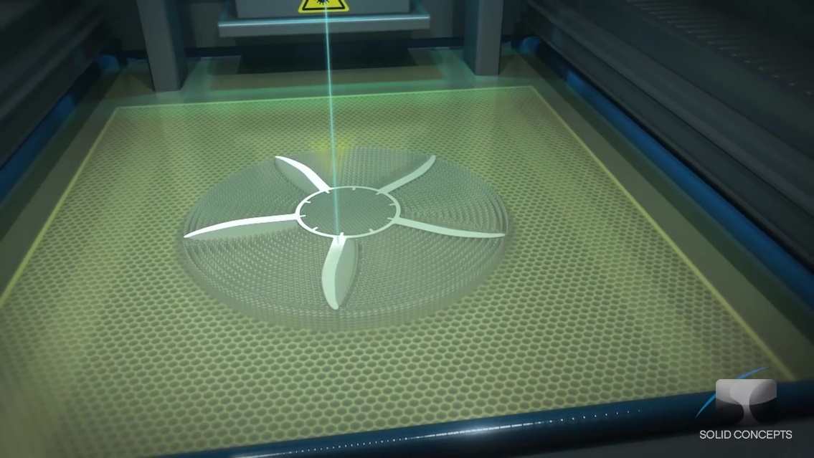
The Big Three (or four)
SLA – StereoLithography Apparatus
Laser hardens a thin layer of photocurable polymer
Examples dating back to 1984
Layers 0.06mm (0.0025in)
Minimum feature size
0.25mm(0.01in)
Watch Video Here
www.lasersintering.com

Slide 5
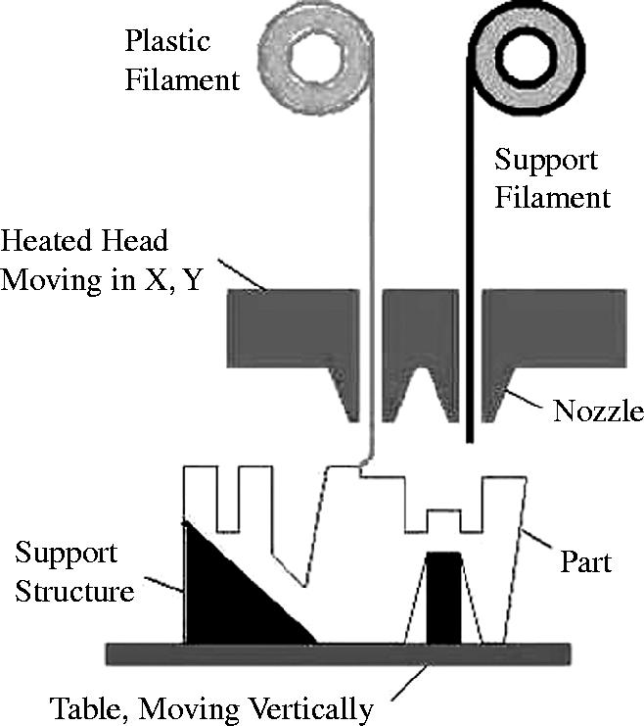
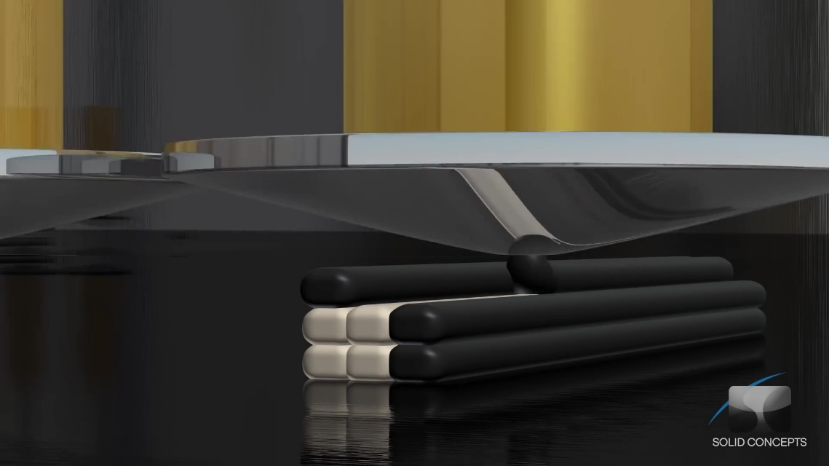
The Big Three (or four)
FDM – Fused Deposition Modeling
Thin stream of plastic is extruded onto a platter
Layers are typically thicker 0.254 mm (0.010 in)
Parts are durable
Minimum feature size
1mm(0.025in)
Watch Video Here
www.emeraldinsight.com

Slide 6
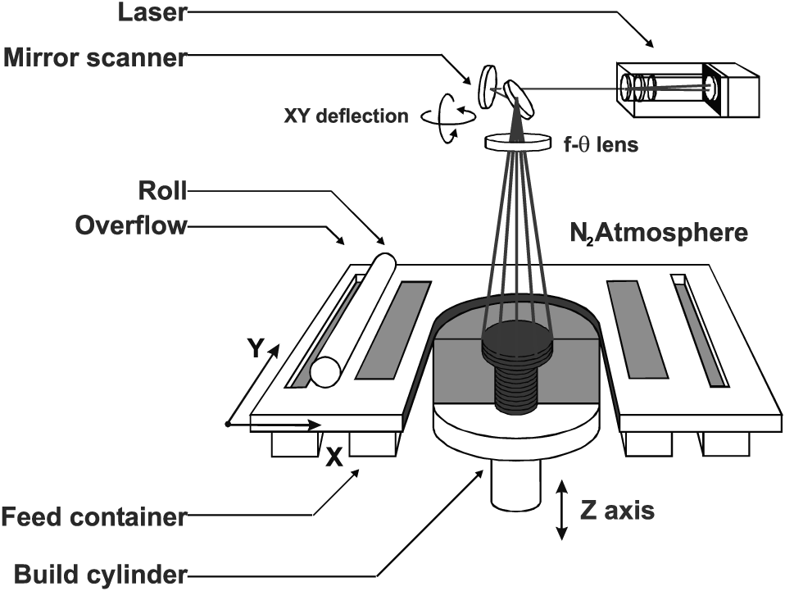
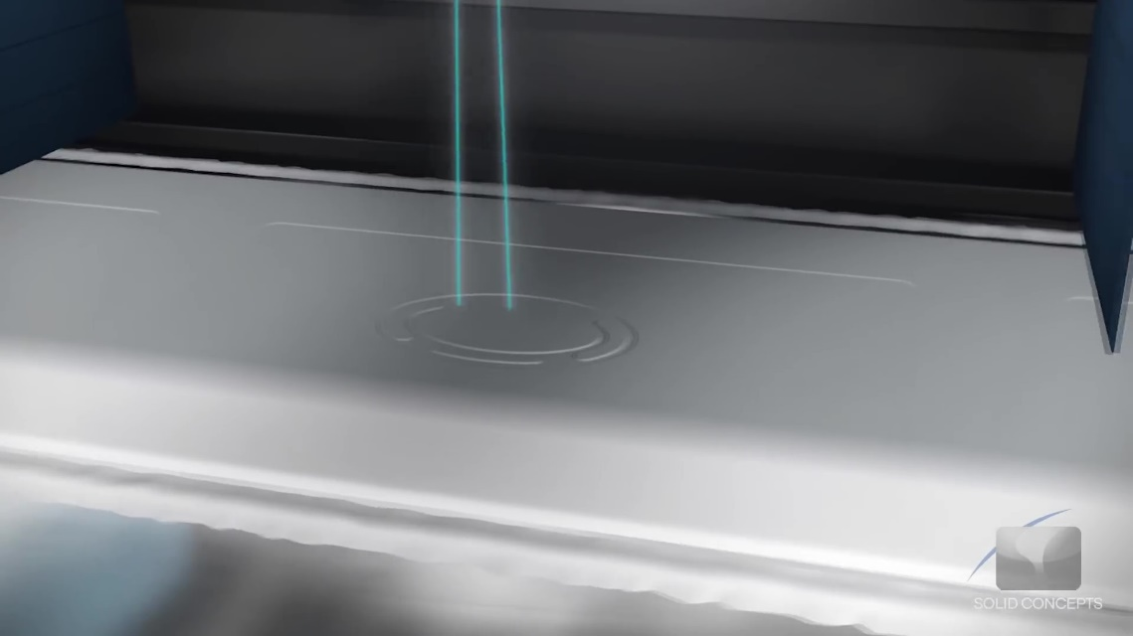
The Big Three (or four)
SLS/SHS – Selective Laser/Heat Sintering
Fine powder is fused with laser or direct heat
Wide range of materials - Nylon, Glass, Ceramic, Steel
Layers 0.1mm (0.004in)
Minimum feature size
0.76mm(0.03in)
Watch Video Here
www.emeraldinsight.com

Slide 7
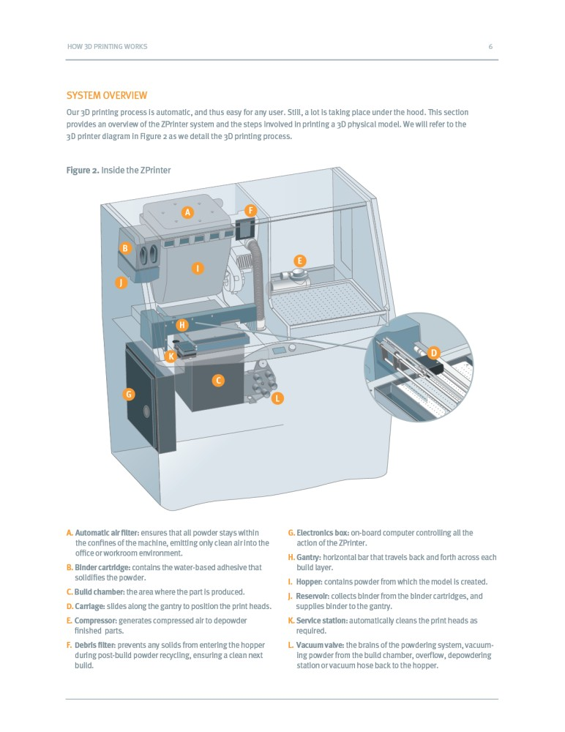
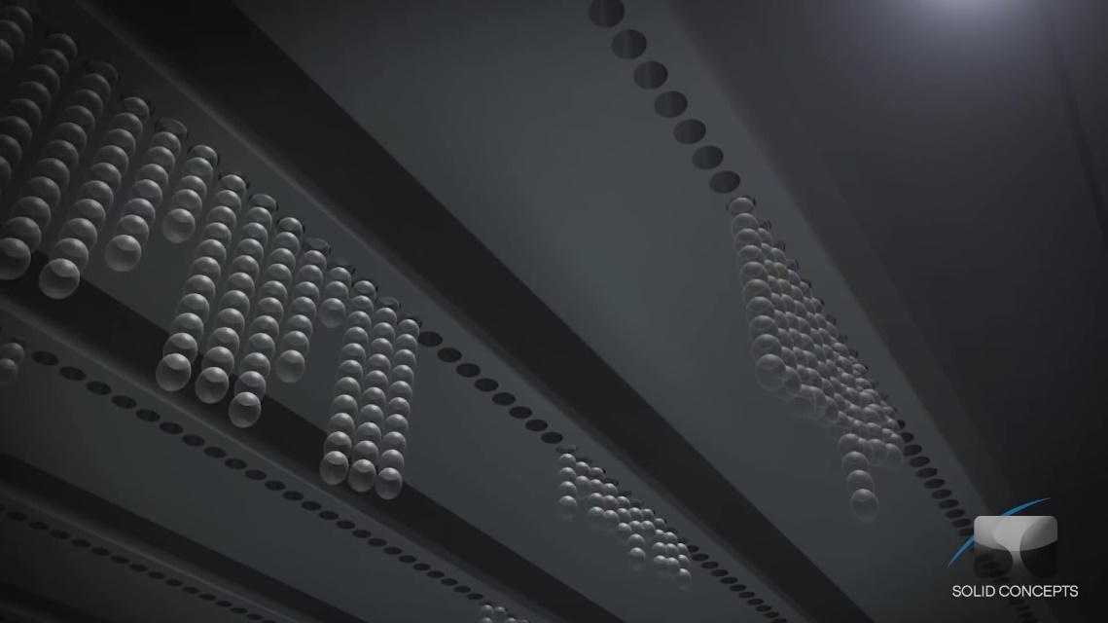
The Big Three (or four)
PolyJet
Fine powder infused w/ binders
Starch
Can print in full color
Layers 0.015mm
Minimum feature size - 0.8mm
Watch Video Here
www.directindustry.com

Slide 8
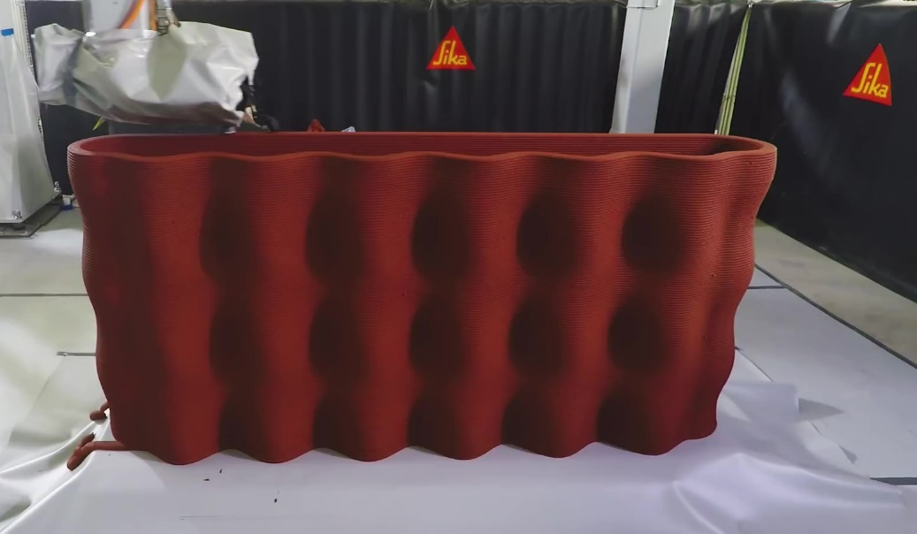
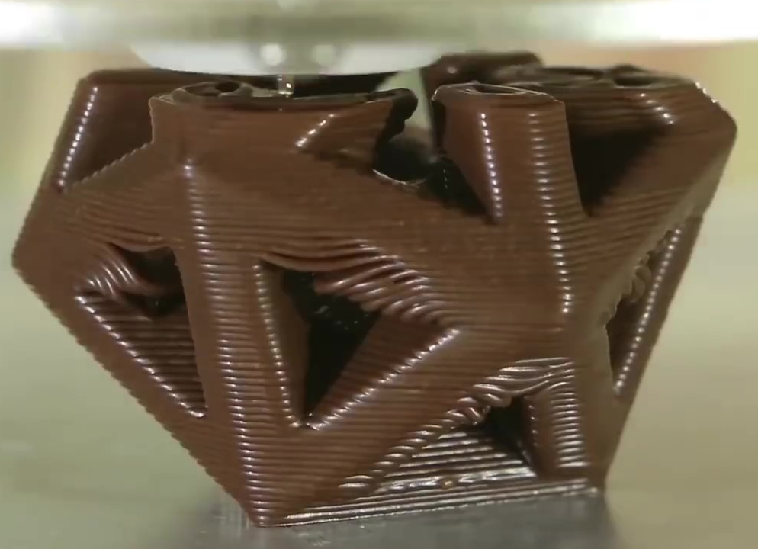
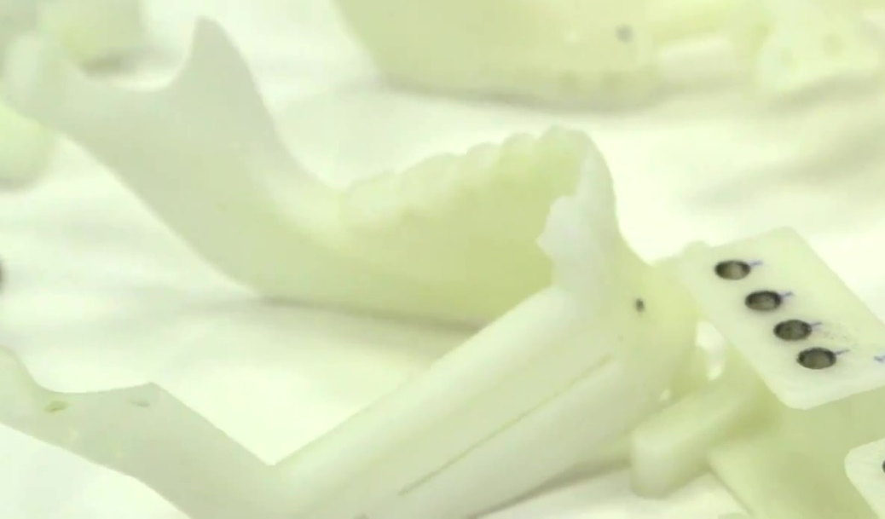
CONCRETE
CHOCOLATE
BONE

